Slide 1
Employee Performance Dashboard

Slide 2
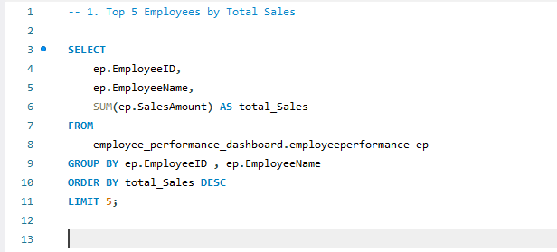
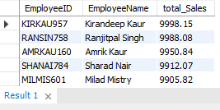
1. Top 5 Employees by Total Sales
MySQL Query
Its Result

Slide 3
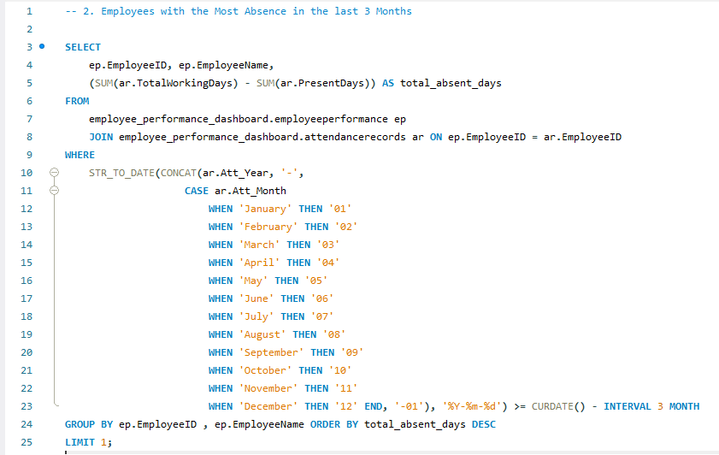
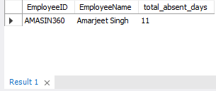
2. Employees with the Most Absence in the last 3 Months
MySQL Query
Its Result

Slide 4
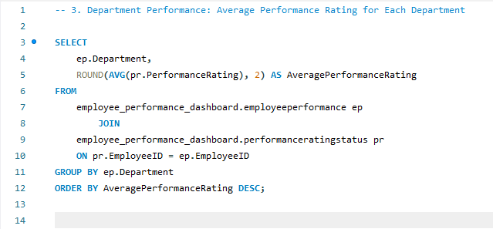
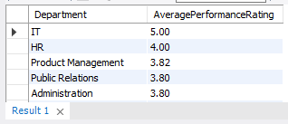
3. Department Performance: Average Performance Rating for Each Department
MySQL Query
Its Result

Slide 5
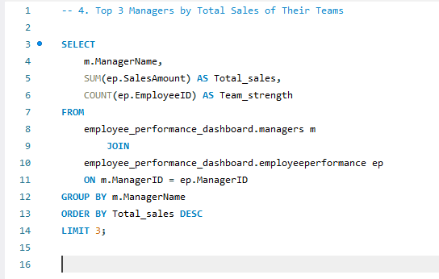
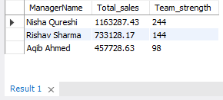
4. Top 3 Managers by Total Sales of Their Teams
MySQL Query
Its Result

Slide 6
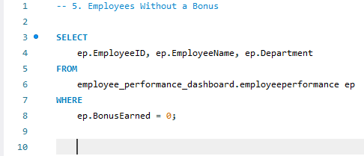
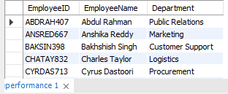
5. Employees Without a Bonus
MySQL Query
Its Result

Slide 7
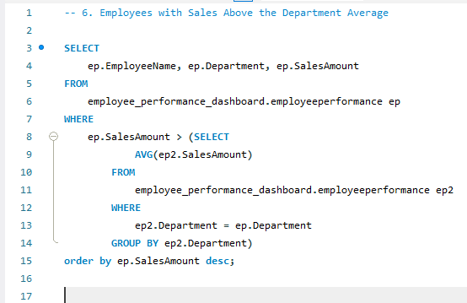
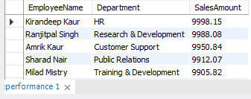
6. Employees with Sales Above the Department Average
MySQL Query
Its Result

Slide 8
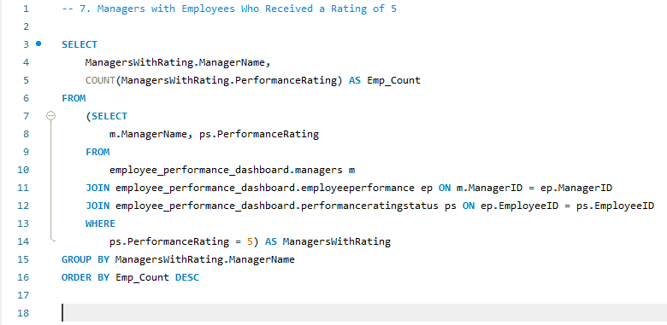
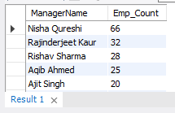
7. Managers with Employees Who Received a Rating of 5
MySQL Query
Its Result

Slide 9
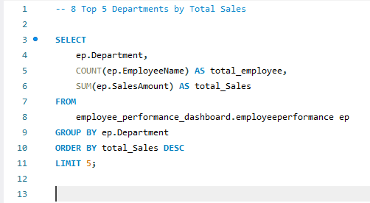
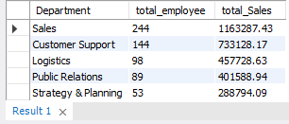
8. Top 5 Departments by Total Sales
MySQL Query
Its Result

Slide 10
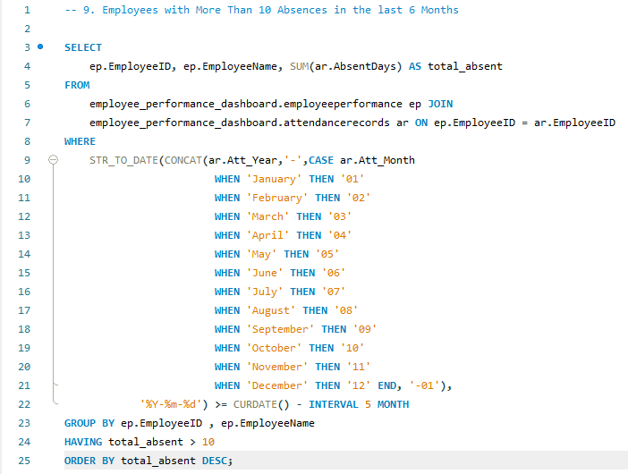
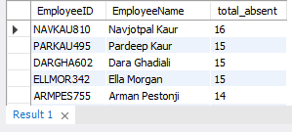
9. Employees with More Than 10 Absences in the last 6 Months
MySQL Query
Its Result

Slide 11
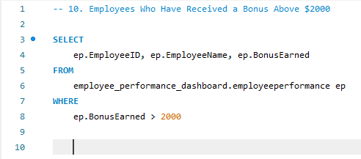
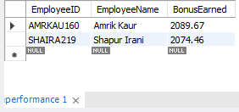
10. Employees Who Have Received a Bonus Above $2000
MySQL Query
Its Result

Slide 12
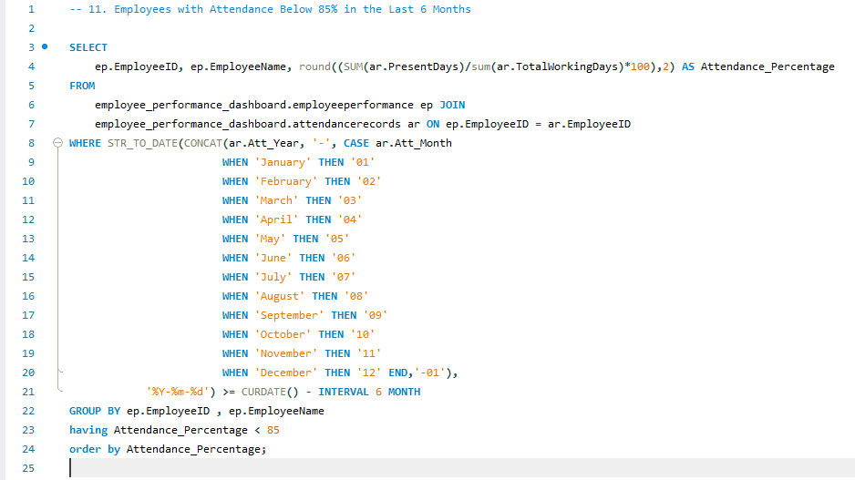
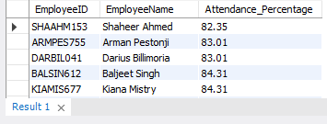
11. Employees with Attendance Below 85% in the Last 6 Months
MySQL Query
Its Result

Slide 13
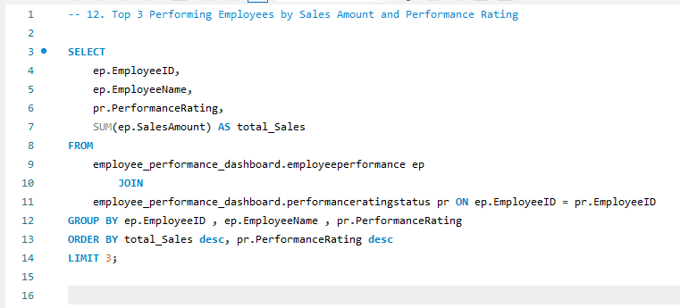
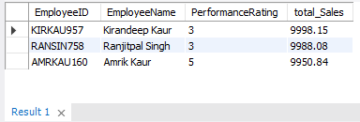
12. Top 3 Performing Employees by Sales Amount and Performance Rating
MySQL Query
Its Result

Slide 14
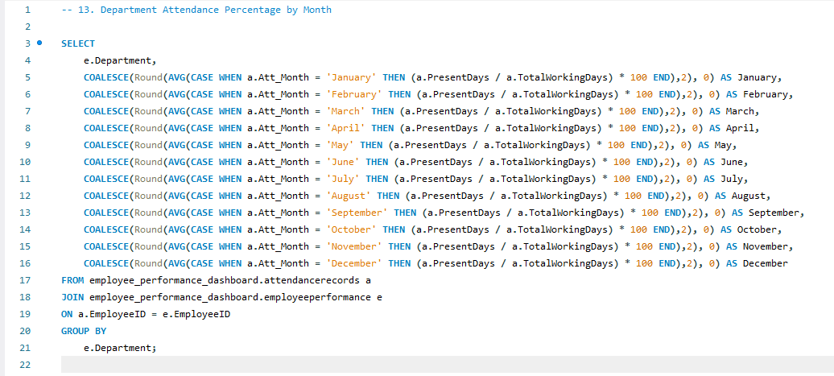
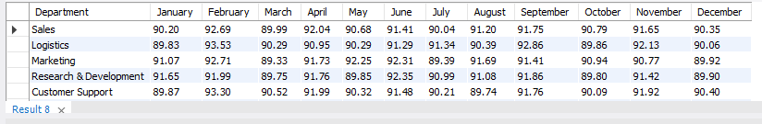
13. Department Attendance Percentage by Month
MySQL Query
Its Result

Slide 15
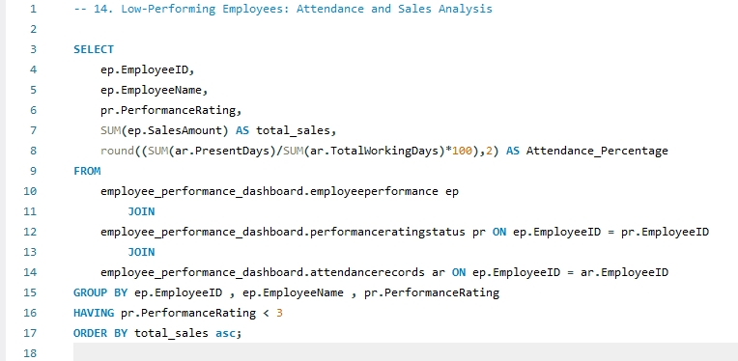
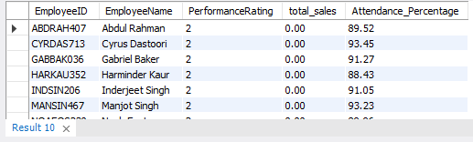
14. Low-Performing Employees: Attendance and Sales Analysis
MySQL Query
Its Result

Slide 16
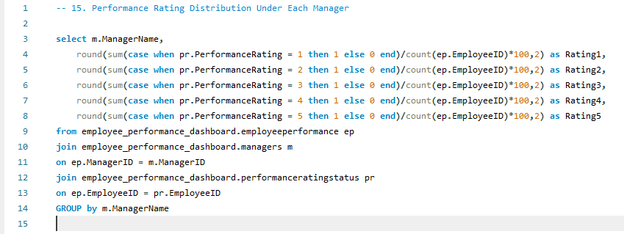
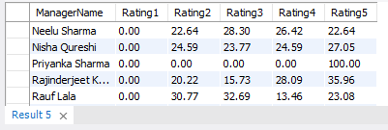
15. Performance Rating Distribution Under Each Manager
MySQL Query
Its Result

